Slide 1
Intro to Python
Georgetown University Hoyalytics

Slide 2

About Your Instructor
Georgetown MSB Alumnus (x2)
20 Years working in financial services
Started programming when I was 10 years old
Matt(eo) Nicoletta

Slide 3
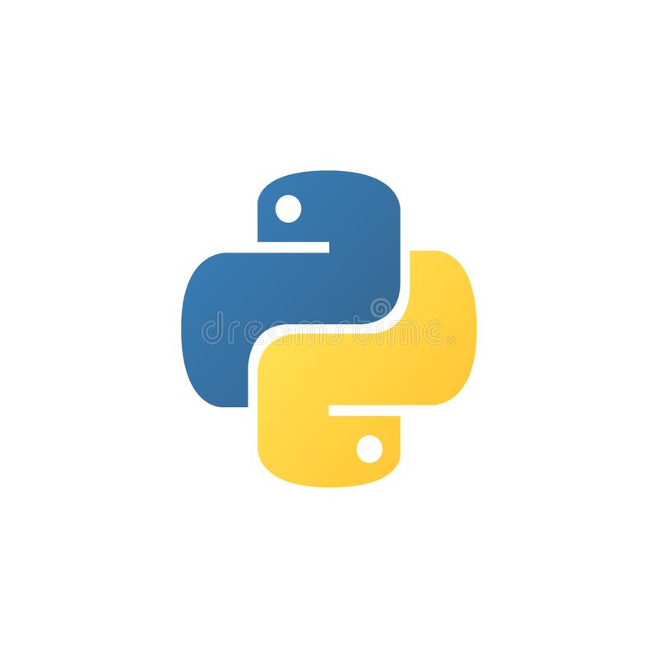


Why Python?
Easy to learn
Actively being developed
Lots of libraries/packages
Flexible/versatile

Slide 4
Python For Beginners.
(What we will cover)
Getting Started with Python using Jupyter Notebooks
Basic Programming Concepts
Example of Using Python for Data Science (pandas)
Course Files https://github.com/matthewnicoletta/Intro-to-Python

Slide 5
Getting Started
Two options:
Install Anaconda https://www.anaconda.com/products/distribution
Use Google Colab https://colab.research.google.com/

Slide 6
Hello, World!
Launch Jupyter Notebooks and open the file Ex1.ipynb
-OR-
Upload the file Ex1.ipynb to Google Colab

Slide 7
Python Data Types
Strings - Text
Numeric (Includes int and float) - Numbers
Boolean - True/False
Sequences (Lists, Sets, Tuples) - Contain multiple items
Dictionaries - Key/Value pairs
Datetime - Temporal values

Slide 8
Control Structures
Sequential - Absent any other structures, code is executed line-by-line in order.
Selection - Choose which code to execute based on tests of condition
Repetition - Perform an action multiple times

Slide 9
Functions & Packages
Like most programming languages, we can define our own functions and load external packages.

Slide 10
Data Science Examples
We have just scratched the surface of Python. Let’s go through some of the more data-oriented things we can do.
These will be demo-style so we can move quickly and cover a lot of concepts without focusing on the nuances of programming.

Slide 11
Further Resources
Python for Everyone: https://www.py4e.com/
RealPython: https://realpython.com/
Kaggle: https://www.kaggle.com/learn/

Slide 12
Contact Me
E-mail:
mjn84@georgetown.edu
LinkedIn: https://www.linkedin.com/in/matthewnicoletta/
Github:
https://github.com/matthewnicoletta/

